Slide 1
Presentation on Flight Price Prediction
Author : Chandan Kumar

Slide 2
Problem Statement
Anyone who has booked a flight ticket knows how unexpectedly the prices vary. The cheapest available ticket on a given flight gets more & less expensive over time. This usually happens as an attempt to maximize revenue based on –
1. Time of purchase patterns (making sure last-minute purchases are expensive)
2. Keeping the flight as full as they want it (raising prices on a flight which is filling up in order to reduce sales and hold back inventory for those expensive last-minute expensive purchases)
So, you have to work on a project where you collect data of flight fares with other features and work to make a model to predict fares of flights.

Slide 3
Web Scraping Strategy employed
Selenium will be used for web scraping data from www.yatra.com
Flights on route of New Delhi to Mumbai in duration of 24 July 2022 to 3 Aug 2022.
Data is scrap in three categories:
Economy class flight price extraction
Business class flight price extraction
Premium Economy class price extraction
Selecting features to be scrap from website.
In next part web scraping code executed for above mention details. Exporting final data in Excel file.

Slide 4
Project Specification
It is a common practice for airlines to pass the cost of aviation fuel to the customer by adjusting the fare to compensate for the fluctuation of crude oil price.
In Another finding , When the flight is at a difference of 2-3 days’ time the ticket price starts increasing again.
Short distance flights are more elastic (more price sensitive) than long distance flights
Business class flights are more inelastic as compared to leisure class as business customers have less flexibility to change or cancel their travel date.

Slide 5


Dataset Information
Dataset contain flight detail of around 2833 Flights on route New Delhi to Mumbai.
Dataset has 11 features like Airlines, flight, Aero plane etc.

Slide 6
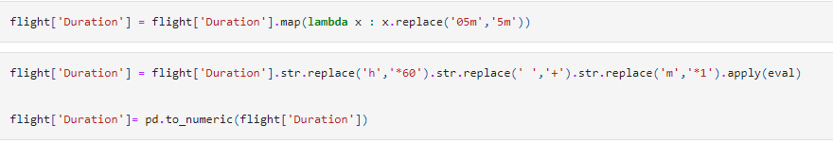
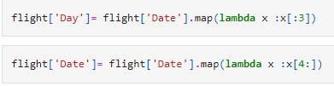
Data Preprocessing
Conversion of Duration column from hr & Minutes format into Minutes .
New column for ‘Day’ & ‘Date’ is extracted from Date column.

Slide 7
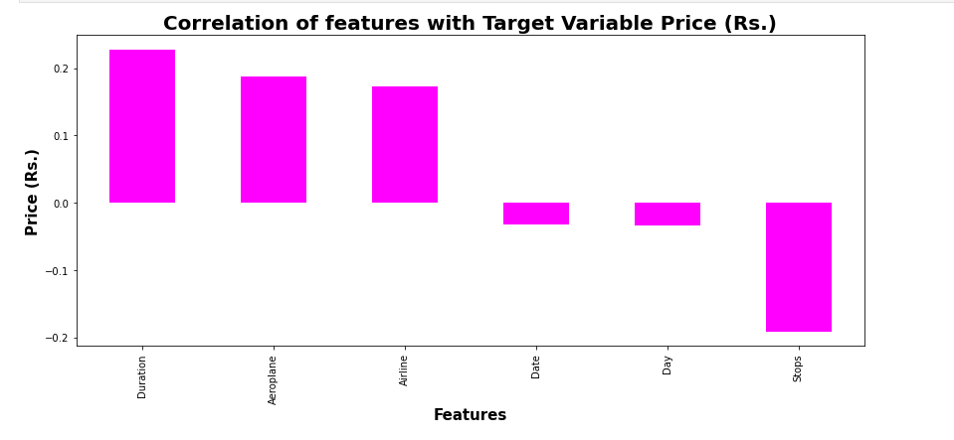
Correlation with Target Variable

Slide 8
Exploratory Data Analysis

Slide 9
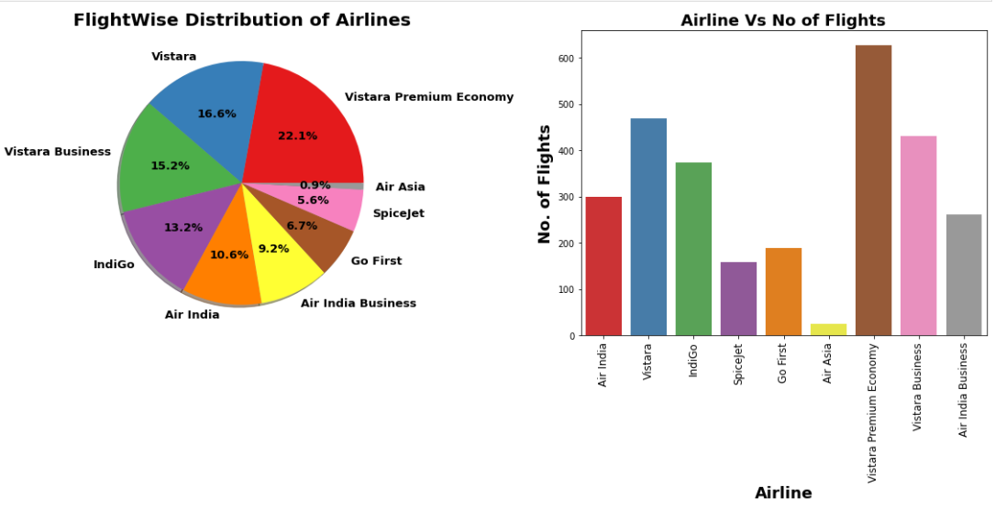
Flight-wise Distribution of Airlines

Slide 10
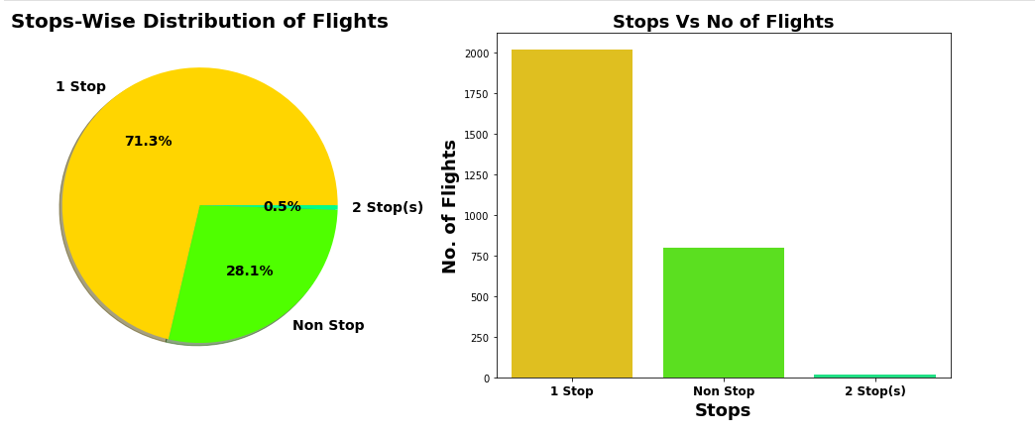
Stop-wise Distribtion of Flightsu

Slide 11
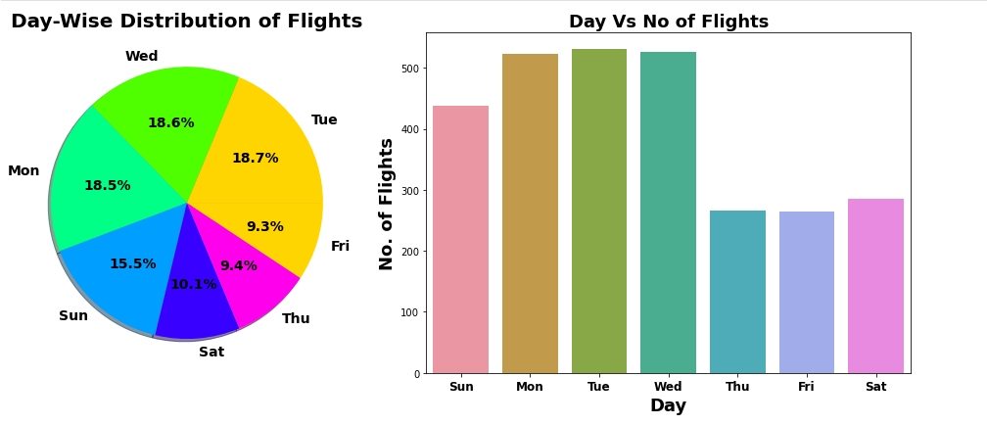
Day-wise Distribution of Flights

Slide 12
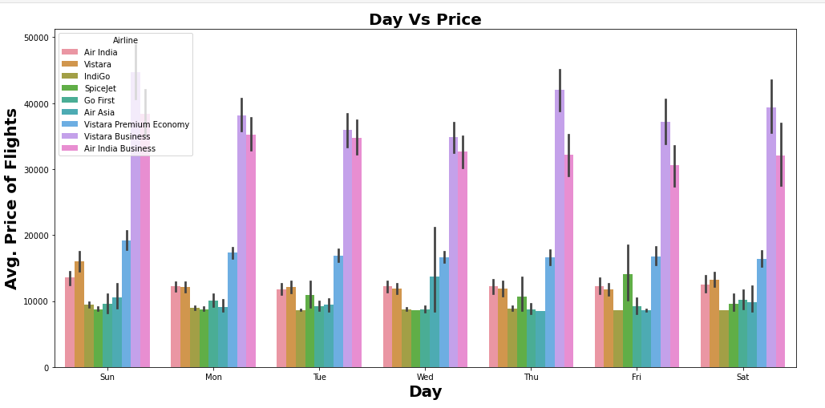
Day Vs Avg. Flight Price

Slide 13
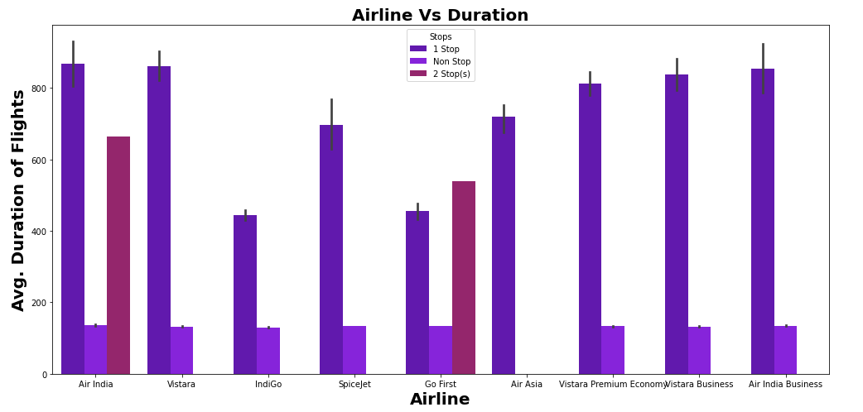
Airline Vs Avg. Duration of Flights

Slide 14
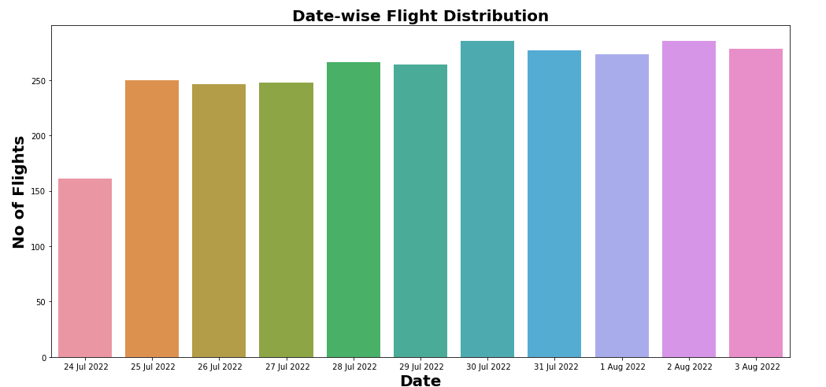
Date-wise Flight Distribution

Slide 15
Machine Learning MODEL BUILDING

Slide 16
Machine Learning Model Building
This problem can be solve using regression-based machine learning algorithm.
Methodology to Build Machine Learning Model:
Encoding Categorical data into Numerical data
Scaling data using Standard Scalar
Splitting data in training & test data using train_test_split from model_selection
Implementing various Regression Based Algorithm to build ML Model
Conducting 5 fold Cross validation
Hyper Parameter tuning of best Model
Saving Final Tuned Model using Joblib

Slide 17
REGRESSION ALGORITHMS IMPLEMENTATION
The different regression algorithm used in this project to build ML model are as below:
Linear Regression
Random Forest Regressor
Decision Tree Regressor
XGB Regressor
Extra Tree Regressor

Slide 18
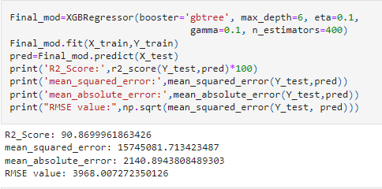
Final ML Hyper Parameter Tuned Model

Slide 19
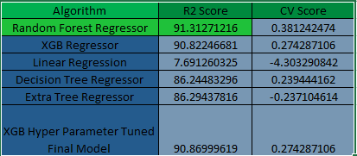
Final Evaluation Matrix

Slide 20
Conclusion
In this study we focus on flights on route of New Delhi to Mumbai, more route can incorporate in this project to extend it beyond present investigation.
This investigation focus on short timeframe (14 days prior flights take off) which can be extended variation over larger period.
Time series analysis can be performed over this model.
Thank You

